Slide 1
DSI Project 4 Web Scraping Job Postings
By Alex Yi Zhou

Slide 2
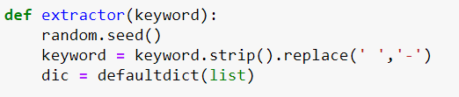




Define function for extracting

Slide 3


Remember to pickle

Slide 4


Cleaning Salary

Slide 5

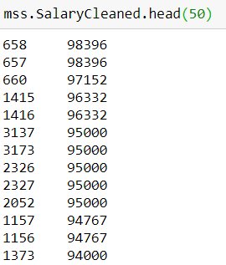
Cleaning Salary cont’

Slide 6
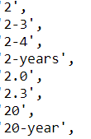
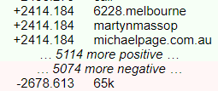
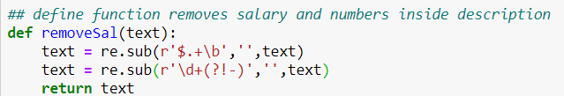
Fine tuning inputs
Experience years doesn’t matter because I am looking for entry positions

Slide 7
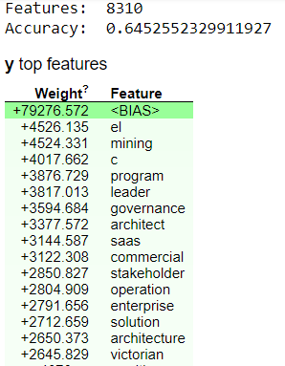
EL = Executive Level

Slide 8
Thank you for listening

